Slide 1
Data Science
Md. Manowarul Islam
Associate Professor, Dept. of CSE
Jagannath University

Slide 2
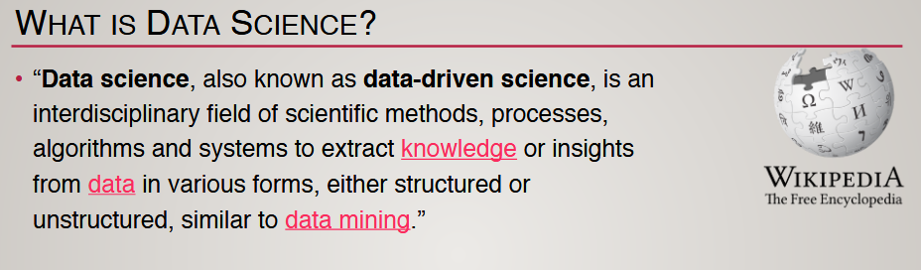
WHAT IS DATA SCIENCE?
Data is a collection of facts.
Data Science is the science which uses computer science, statistics and machine learning, visualization and human-computer interactions to collect, clean, integrate, analyze, visualize, interact with data to create data products.

Slide 3
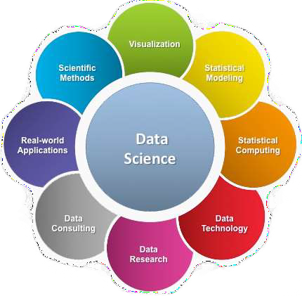
WHAT IS DATA SCIENCE?
A multi-disciplinary field that uses scientific methods, processes, algorithms and systems to extract knowledge and insights from structured and unstructured data.
Source: https://bit.ly/30dekJB

Slide 4
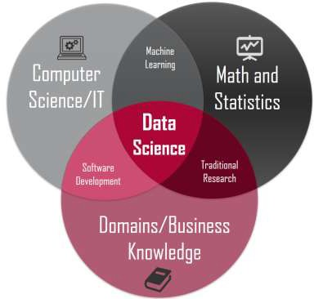
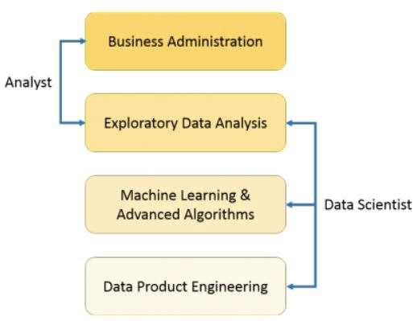
WHAT IS DATA SCIENCE?
WHAT IS DATA SCIENCE?
A "concept to unify statistics, data analysis, machine learning and their related methods" in order to "understand and analyze actual phenomena" with data.
Employs techniques and theories drawn from many fields within the context of mathematics, statistics, computer science, and information science.

Slide 5
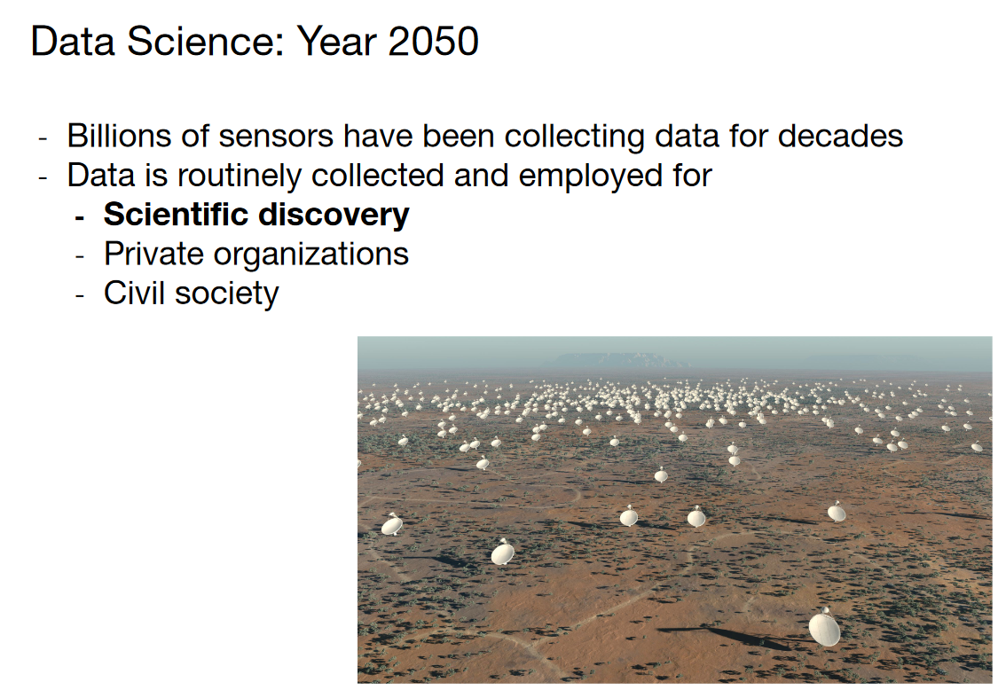

Slide 6
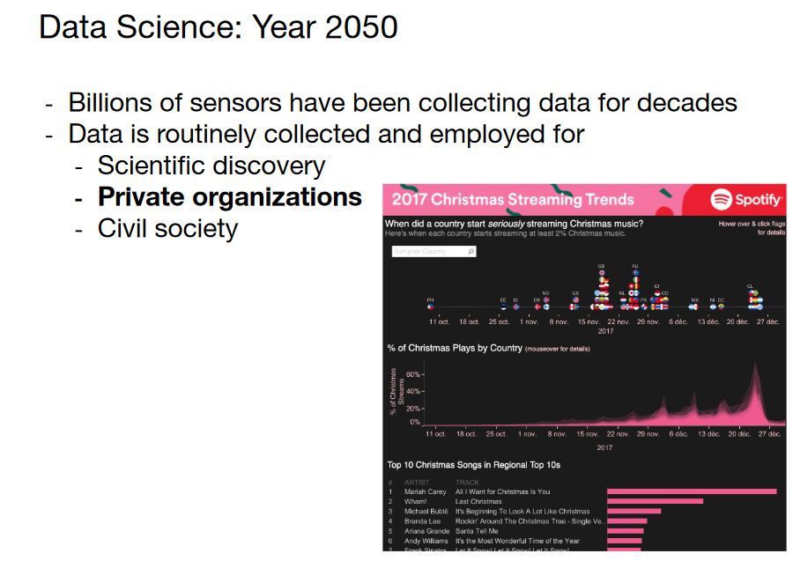

Slide 7
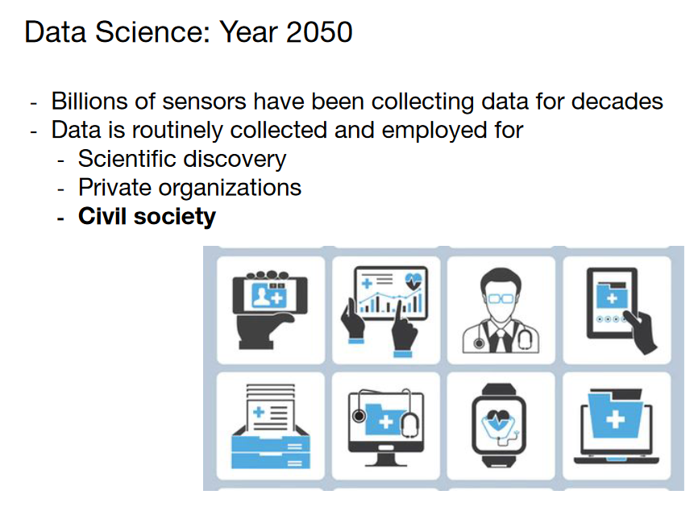

Slide 8
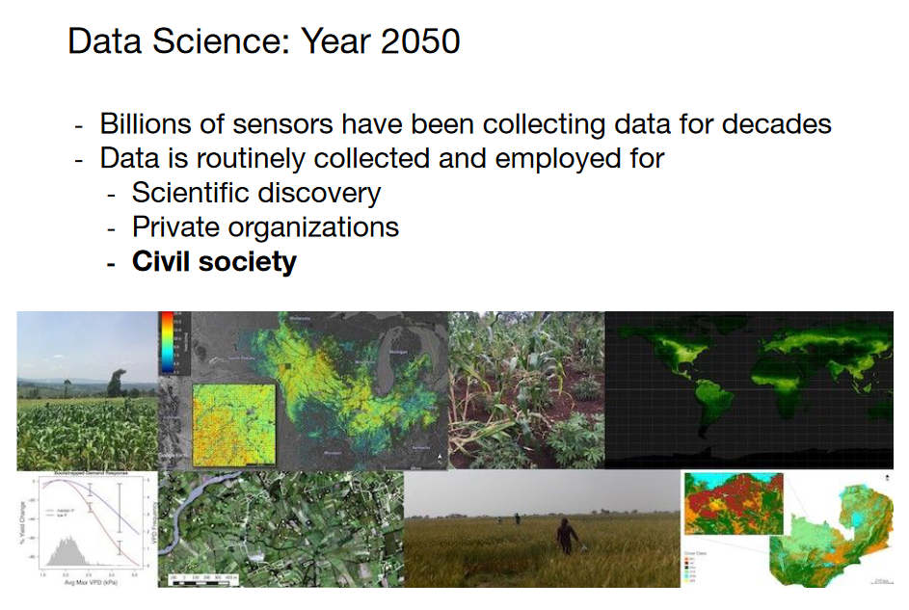

Slide 9
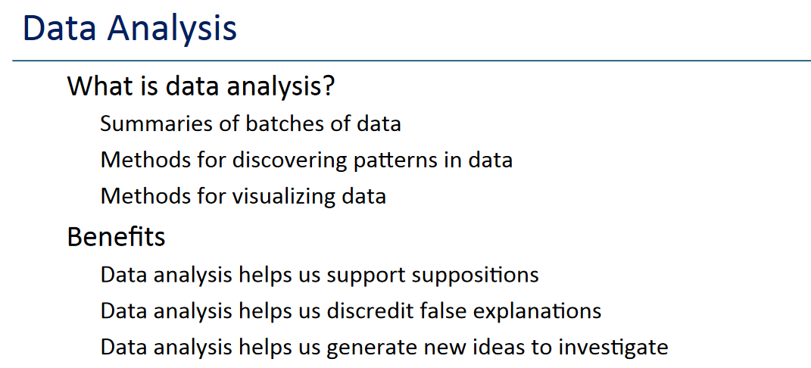

Slide 10
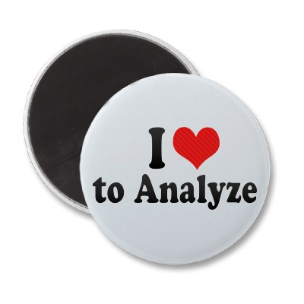
Data Analysis
Analysis: Turning raw data
into useful information
Purpose: To provide answers to questions being asked by a health program
Even the greatest amount and best quality of data mean nothing if data are not properly analyzed—or analyzed at all.
Notes:
Although the terms “data” and “information” often are used interchangeably, there is a distinction.
Data refers to raw, unprocessed numbers, measurements, or text.
Information refers to data that are processed, organized, structured, or presented in a specific context. The process of transforming data into information is data analysis.
NOTE to facilitator: Read slide.

Slide 11
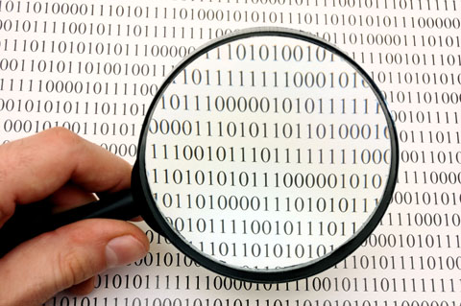
Data Analysis
Analysis does not mean using a computer software package.
Analysis is looking at the data in light of the questions you need to answer:
How would you analyze data to determine: “Is my program meeting its objectives?”
Notes:
Data analysis does not necessarily mean using a complicated computer analysis package. It means taking the data that you collect and looking at them in the context of the questions that you need to answer.
For example, if you need to know whether your program is meeting its objectives, or if it’s on track, you would look at your program targets and compare them to the actual program performance. This is analysis.
Later, we will take this one step further and talk about interpretation. (For example, through analysis, you find that your program achieved only 10% of its target; now you have to figure out why).

Slide 12
Answering Program Questions
Question: Is my program meeting its objectives?
Analysis: Compare program targets and actual program performance to learn how far you are from the targets
Interpretation: Why have you achieved or not achieved a target, and what does this mean for your program?
Answering may require more information.
Notes:
With regard to data demand and use (DDU), we talk a lot about answering programmatic questions. Let’s take a minute to discuss what that means.
Suppose you need to know if your program is on track. You probably would look at your program targets and compare them to the actual program performance. This is analysis.
Interpretation is using the analysis to further explore your findings and understand the implications for your program. In many cases, this means using additional information, such as vital statistics, population-based surveys, and qualitative data, to supplement the routine service statistics.
NOTE to facilitator: Read the slide.

Slide 13
How to use data?
Data => exploratory analysis => knowledge models => product / decision making
Data => predictive models => evaluate / interpret => product / decision making
Exploratory analysis tells us what happened.
Predictive analysis tells us what could happen next!

Slide 14
Data science applications
Marketing: predict the characteristics of high life time value (LTV) customers, which can be used to support customer segmentation, identify upsell opportunities, and support other marketing initiatives
Logistics: forecast how many of which things you need and where will we need them, which enables learn inventory and prevents out of stock situations
Healthcare: analyze survival statistics for different patient attributes (age, blood type, gender, etc.) and treatments; predict risk of re-admittance based on patient attributes, medical history, etc.

Slide 15
Data science applications
Transaction Databases → Recommender systems (NetFlix), Fraud Detection (Security and Privacy)
Wireless Sensor Data → Smart Home, Real-time Monitoring, Internet of Things
Text Data, Social Media Data → Product Review and Consumer Satisfaction (Facebook, Twitter, LinkedIn), E-discovery
Software Log Data → Automatic Trouble Shooting (Splunk)
Genotype and Phenotype Data → Epic, 23andme, Patient-Centered Care, Personalized Medicine

Slide 16
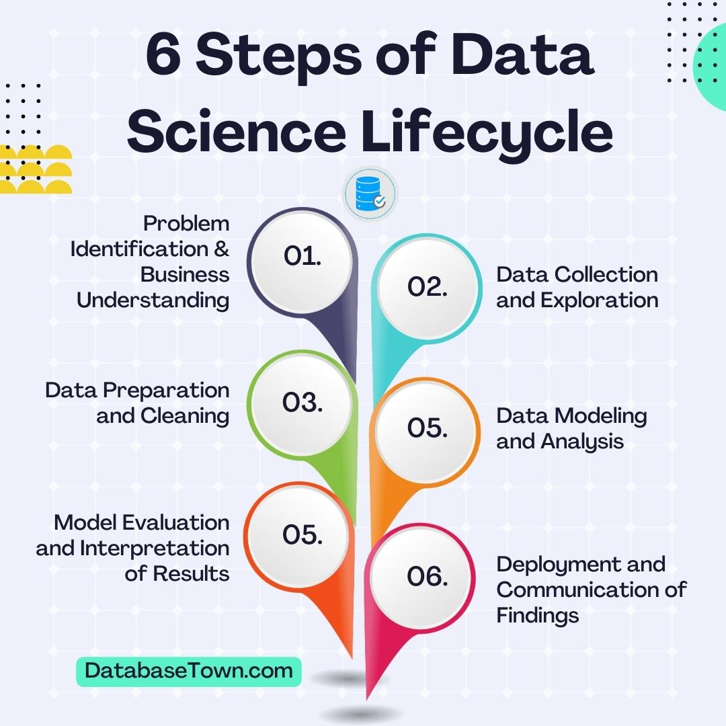
Data Science Life cycle

Slide 17
1 - Problem Identification & Business Understanding
The foremost stage of the data science life cycle involves defining the business problem. You need to understand the real-world issues faced by your business and then articulate how data science can help address them. This may include predicting customer churns, estimating product demand or optimizing marketing efforts. By placing a framework in place at this stage for evaluating potential solutions, it helps streamline the next steps and forms a foundation for measuring success.
DatabaseTown.com

Slide 18
2 - Data Collection and Exploration
Once problem is clearly defined, data collection becomes a critical aspect of the data science life cycle. This stage entails gathering raw data from various sources like databases, spreadsheets, web scraping or APIs. Make sure you include possible external influences as well, such as seasonal trends and economic indicators.
Having enough good-quality data is important for building accurate models later in the project. Moreover, while collecting data, it's crucial to maintain its originality and keep track of its provenance for transparency and reproducibility purposes.
Data acquisition can take various forms according to nature of the problem and the specific requirements of the project. It may involve accessing publicly available datasets, such as government databases, open data repositories, or industry-specific data sources. These datasets can provide a wealth of information and serve as a foundation for analysis.
DatabaseTown.com

Slide 19
3 - Data Preparation and Cleaning
Data, in its raw form, is frequently riddled with inconsistencies, missing values, and other irregularities that can hinder effective analysis. Therefore, in the data science lifecycle, the data preparation phase plays a critical role in transforming raw data into a clean and usable format. This crucial step ensures that the data is reliable, accurate, and ready for analysis, setting the stage for meaningful insights to be extracted.
During the data preparation phase, data scientists employ a range of techniques to address the various challenges posed by the raw data. One common task involves handling missing values, which are data points that are absent or incomplete. Missing values can significantly impact the accuracy of analyses, as they introduce uncertainty and potentially bias the results. Data scientists use strategies such as imputation, where missing values are estimated or replaced using statistical methods, to ensure that the data remains robust and representative.
DatabaseTown.com

Slide 20
4 - Data Modeling and Analysis
In this stage of the data science lifecycle, data scientists use statistical and machine learning techniques to analyze the prepared data. By applying these techniques, they extract meaningful information, make accurate predictions, and gain a deeper understanding of the underlying insights within the data. This phase is characterized by tasks such as feature selection, model training and performance evaluation. All of these contribute to the successful analysis and interpretation of the data.
One essential task during this stage is feature selection. Data scientists carefully choose the relevant features or variables from the dataset that are most informative and influential for the analysis. By selecting the right set of features, they can simplify the modeling process, enhance the interpretability of results, and reduce the risk of overfitting.
DatabaseTown.com

Slide 21
5 - Model Evaluation and Interpretation of Results
Once the data models have undergone training and predictions have been generated, the subsequent step in the data science lifecycle is to evaluate the results. Data scientists meticulously assess the performance of their models and validate the accuracy of the predictions against the ground truth or known outcomes. This evaluation process plays a crucial role in determining the effectiveness of the models and gaining valuable insights into the analyzed data.
During the evaluation stage, data scientists employ various techniques to analyze and interpret the results. Statistical analysis is a fundamental approach used to assess the performance metrics of the models. These metrics can include accuracy, precision, recall, F1 score, or other domain-specific measures depending on the nature of the problem.
DatabaseTown.com

Slide 22
6 - Deployment and
Communication of Findings
In the deployment stage of the data science lifecycle, data scientists focus on translating their models and findings into real-world solutions. This process needs integration of models into existing systems, building interactive dashboards, or creating application programming interfaces to facilitate easy access and utilization.
Integrating the trained models into existing systems involves integrating analytical models into the operational infrastructure of an organization. By integrating the models, the organization can automate decision-making processes, optimize resource allocation, or improve operational efficiency based on the insights gained from the data analysis.
Read the complete post about data science life cycle
DatabaseTown.com

Slide 23
What Is Data Mining?
Data mining (knowledge discovery from data)
Extraction of interesting (previously unknown and potentially useful) patterns or knowledge from huge amount of data
Data mining: a misnomer?
Alternative names
Knowledge discovery (mining) in databases (KDD), knowledge extraction, data/pattern analysis, data archeology, data dredging, information harvesting, business intelligence, etc.
Watch out: Is everything “data mining”?
(Deductive) query processing.
Expert systems or small ML/statistical programs

Slide 24
What is Data Mining? Real Example from the NBA
Play-by-play information recorded by teams
Who is on the court
Who shoots
Results
Coaches want to know what works best
Plays that work well against a given team
Good/bad player matchups
Advanced Scout (from IBM Research) is a data mining tool to answer these questions
Starks+Houston+
Ward playing
http://www.nba.com/news_feat/beyond/0126.html

Slide 25
Data Mining—What’s in a Name?
Information Harvesting
Data Mining
Knowledge Mining
Knowledge Discovery
in Databases
Data Dredging
Data Pattern Processing
Data Archaeology
Database Mining
Knowledge Extraction
The process of discovering meaningful new correlations, patterns, and trends by sifting through large amounts of stored data, using pattern recognition technologies and statistical and mathematical techniques

Slide 26
Integration of Multiple Technologies
Machine
Learning
Artificial
Intelligence
Database
Management
Statistics
Algorithms
Visualization
Data
Mining
Notes:
10

Slide 27
Data Mining: Confluence of Multiple Disciplines
Database
Systems
Statistics
Machine
Learning
Data Mining
Visualization
Algorithm
Other
Disciplines

Slide 28
Data Mining Process
A manifestation of best practices
A systematic way to conduct DM projects
Different groups has different versions
Most common standard processes:
CRISP-DM (Cross-Industry Standard Process for Data Mining)
SEMMA (Sample, Explore, Modify, Model, and Assess)
KDD (Knowledge Discovery in Databases)

Slide 29
Data Mining Process: CRISP-DM

Slide 30
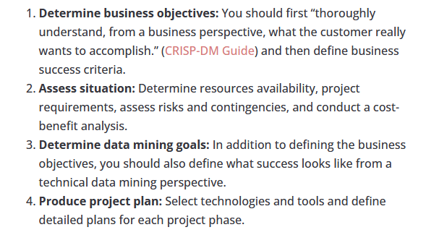
Data Mining Process: CRISP-DM

Slide 31
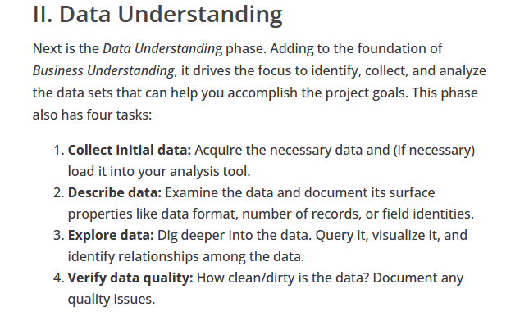
Data Mining Process: CRISP-DM

Slide 32
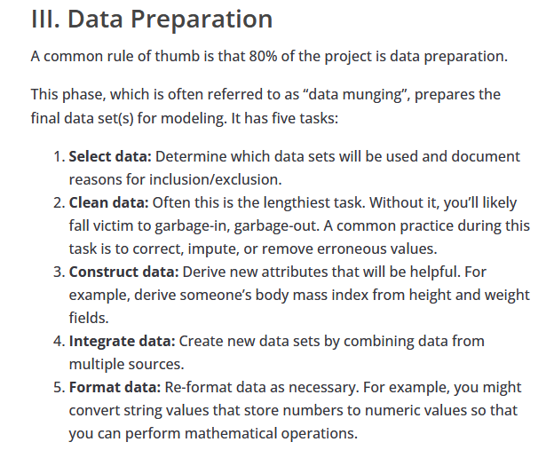
Data Mining Process: CRISP-DM

Slide 33
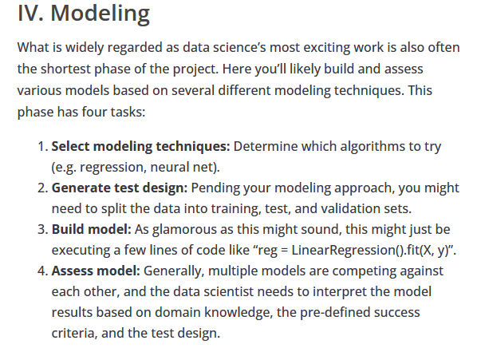
Data Mining Process: CRISP-DM

Slide 34
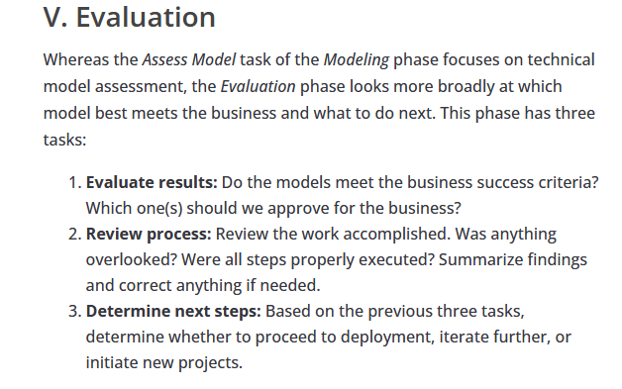
Data Mining Process: CRISP-DM

Slide 35

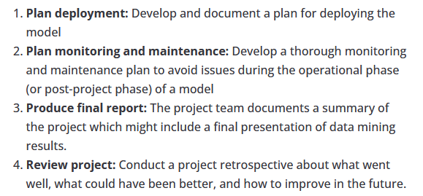
Data Mining Process: CRISP-DM

Slide 36
Data Mining Process: CRISP-DM
Step 1: Business Understanding
Step 2: Data Understanding
Step 3: Data Preparation (!)
Step 4: Model Building
Step 5: Testing and Evaluation
Step 6: Deployment
The process is highly repetitive and experimental (DM: art versus science?)
Accounts for ~85% of total project time

Slide 37
Data Preparation – A Critical DM Task

Slide 38
Data Mining Process: SEMMA

Slide 39
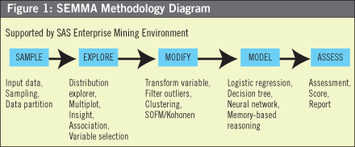
Data Mining Process: SEMMA

Slide 40
Knowledge Discovery in Databases: Process
Interpretation/
Evaluation
Data Mining
Knowledge
Preprocessing
Patterns
Selection
Preprocessed
Data
Data
Target
Data
Notes:
Mine for:
Selection
Aggregation
Abstraction
Visualization
Transformation/Conversion
Statistical Analysis
“Cleaning”

Slide 41
Thanks

